Slide 1
Linux System Administration
4-File System Management 文件系统管理

Slide 2

文件系统 File System Level
Data and Files 数据与文件
  What is data ? 什么是数据
    Data is information that has been converted to a machine-readable, digital binary format. 数据是被转换为机器可读的数字二进制信息
    Control information indicates how data should be processed. 控制信息表明数据如何被处理

Slide 3
文件系统 File System Level
Data and Files 数据与文件
  Files are the common containers for user data, application code, and operating system executables and parameters. 文件是用户数据、应用代码、操作系统可执行体和参数等的容器。

Slide 4
文件系统 File System Level
About the files
  Metadata 元数据
    The control information for file management is known as metadata. 元数据是文件管理相关的控制信息
    File metadata includes file attributes and pointers to the location of file data content. 包括文件属性、文件数据内容位置
    File metadata may be segregated from a file‘s data content. 文件元数据可能跟文件数据不在一起
    Metadata on file ownership and permissions is used in file access. 文件所有权和访问许可
    File timestamp metadata facilitates automated processes such as backup and life cycle management. 文件时间戳
  Different file systems
    In Unix systems, file metadata is contained in the i-node structure.
    In Windows systems, file metadata is contained in records of file attributes.
Notes:
文件记录：记录当前分区有哪些文件

Slide 5
文件系统 File System Level
File system 文件系统
  A file system is a software layer responsible for organizing and policing the creation, modification, and deletion of files on disk. 操作系统用来组织管理文件的软件模块
Notes:
The way the data structures are implemented defines:
how many files can be saved
the size of the files
integrity of data in the case of a failure
interesting other features (e.g. copy-on-write, snapshotting)
There are several implementations of file systems that handle how data is tracked and managed on a particular disk, here are a few common ones:

Slide 6
文件系统 File System Level
A filesystem is comprised of various data structures and metadata that map information about the files on your disk including:
  What sections of the disk are free
  What sections of the disk have errors (and should not be used)
  Where chunks of data actually live (along with the actual data itself)
Notes:
The way the data structures are implemented defines:
how many files can be saved
the size of the files
integrity of data in the case of a failure
interesting other features (e.g. copy-on-write, snapshotting)
There are several implementations of file systems that handle how data is tracked and managed on a particular disk, here are a few common ones:

Slide 7
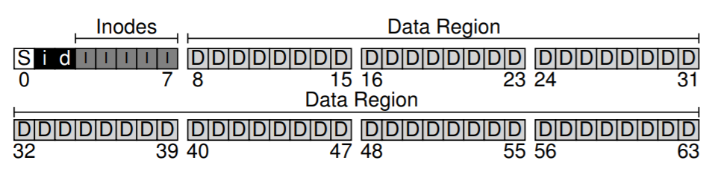
文件系统 File System Level
Different File system不同文件系统
  In Unix, the super block contains information on the current state of the file system and its resources. 超级块记录当前文件系统状态
  In Windows NTFS, the master file table contains information on all file entries and status. 主文件表记录所有文件条目与状态信息
Notes:
超级块包含了i节点表 和 空闲块表 等重要的文件系统信息

Slide 8
文件系统 File System Level
When mounting a file system, the operating system will read the superblock first, to initialize various parameters, and then attach the volume to the file-system tree. 将文件系统挂载到操作系统时，操作系统首先读取超级块。

Slide 9
文件系统 File System Level
Superblock contains information about this particular file system, including, for example, how many inodes and data blocks are in the file system, where the inode table begins。

Slide 10
Hard Drives
When using a computer, persistent storage is needed.
On typical computer systems, this is done via a hard drive (spinning disk) or solid state disk
  HDDs and SSDs are block storage devices
  Blocks are a static number of bits, which is typically 4 KiB on modern disks
Since such disks are devices, they will be detected by the kernel and populated into the /dev folder on a Linux machine.

Slide 11
Hard Drives
Depending on the type of disk, the naming convention will change.
  Here are a few common ones, where X is a letter a-z and Y is a number:
    /dev/sdX
      SCSI and SATA drives
      Example: /dev/sda
    /dev/hdX
      IDE drives (the legacy, giant ribbon cable)
      Example: /dev/hdb
    /dev/nvmeY
      PCI-express attached drives

Slide 12
Partitions
Hard drives provide the raw storage for data, but partitions slice up this storage into "compartments" that can be used for different purposes.
Partitions define what blocks (beginning and end) on the raw storage can be used for a particular purpose
Partition will be named numerically based on the count of the partition on disk. They are based on the disk device. Here are a few examples:
  SATA Disk 1, Partition 1:
    /dev/sda1
  SATA Disk 2, Partition 1:
    /dev/sdb1
  SATA Disk 2, Partition 2:
    /dev/sdb2
Each partition is tagged with a type which defines what kind of data can be stored there. Here are a few common types:

Slide 13
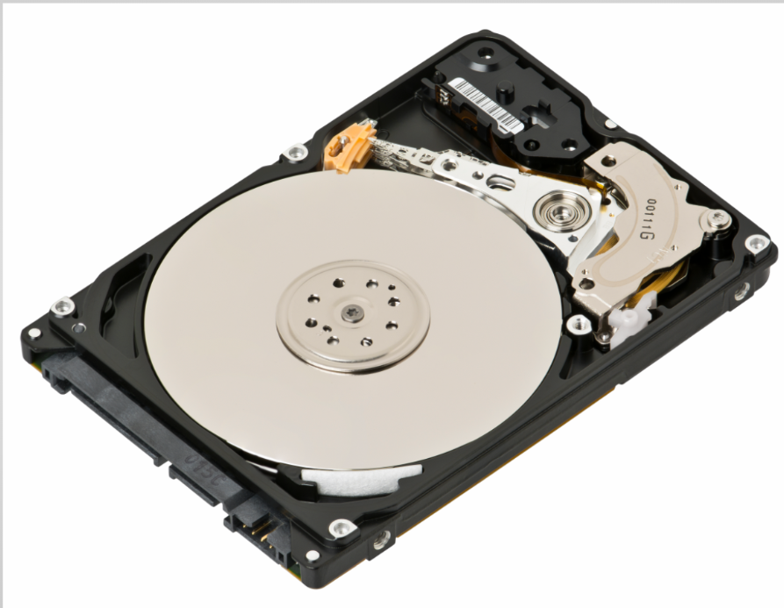
Hard Drives 硬盘

Slide 14
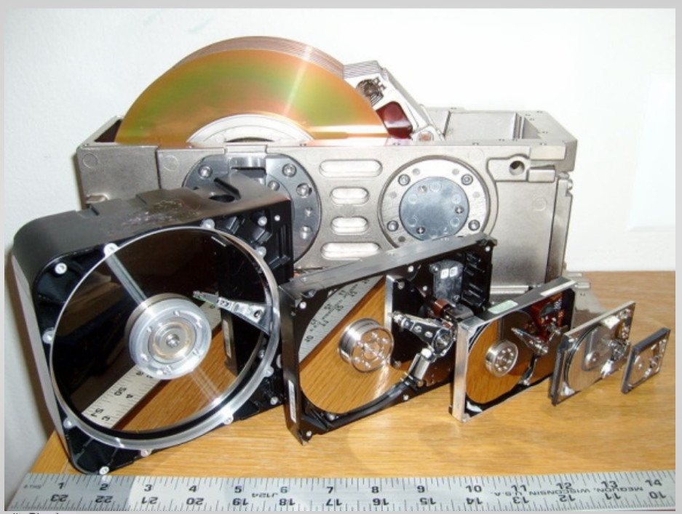
Hard Drive History

Slide 15
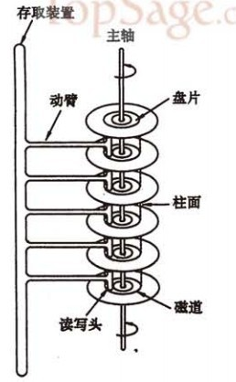
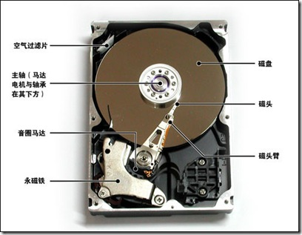
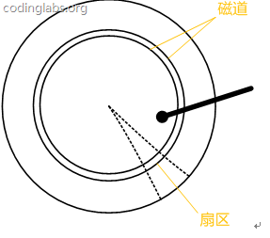
Structure of Hard Drive 硬盘结构
What is Storage?
  Magnetic track磁道, Sector扇区, cylinder柱面
  Seek Time, Rotating Time
具体请参考https://blog.csdn.net/hguisu/article/details/7408047
Notes:
磁铁有两个极性, 一个是南极(S极) , 一个是北极(N 极) , 硬盘正是利用磁粒子的极性来记录数据的。盘片表面的那些磁粉就是磁粒子。盘片被划分成若干个同心圆( 称为磁道),在每个同心圆的磁道上就好像有无数的任意排列的小磁铁, 当这些小磁铁受到来自磁头磁场的影响时,排列的方向随之改变, 利用磁头的磁力统一某区域小磁铁的方向, 就可以使该区域磁场呈现相同极性, 如果把 S/N 两种极性与二进制中的 0和 1 对应, 就可以表示二进制数据, 这些磁粒子都是永磁体, 即便磁头离开, 它依然可以长时间保持形成的极性, 这样就能达到储存信息的目的了。磁头在读取数据时, 可以感应磁粒子的不同极性, 从而转换成不同的电脉冲信号, 利用解码器将这些原始信号翻译出来, 就成为了电脑能使用的数据。
现在制造硬盘的技术通常为温彻斯特技术，最早把温彻斯特技术放在小型驱动器上的是IBM，其62-PC，首次采用直径为20.3厘米的盘片。此后CDC公司、NEC公司开始生产20.3厘米的硬盘驱动器。 1980年Shugart公司首先制成13.3厘米硬盘驱动器，体积的更小型化，但其容量只有6MB。1983年，Rodime公司也制成了13.3厘米的硬盘驱动器，容量也仅有6MB左右。
硬盘另外一个发展里程碑就是使用溅射工艺来生产连续介质，这样就让硬盘的密度进一步增大，为提高硬盘的存储空间奠定了良好的基础。1991年IBM首次实现了1Gbit/英寸的密度，1992年日立公司则达到2Gbit/英寸，1997年又是IBM公司领先一步，得到了11.6Gbit/英寸的实验结果。1998年Seagate公司实现了16.3Gbit/英寸的密度，1999年IBM又推出了更加大的27.6Gbit/英寸。硬盘中磁头同盘片之间的距离很小，一般来说只有十万分之一厘米，因此一张小小的硬盘可以存下如此多的数据并不稀奇。

Slide 16

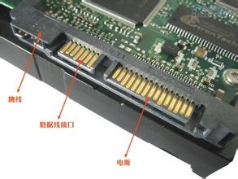
Typical Block Device Interfaces
ATA（Advanced Technology Attachment）
ATA硬盘(IDE:Integrated Drive Electronics)，一种并行总线硬盘，转速为7200RPM，主流容量通常有80GB、250GB等
SATA（Serial ATA）
串口硬盘，采用点对点的连接方式，支持热插拔。转速为7200RPM，主要容量有750GB、1TB、2TB、4TB等。目前被广泛应用家用PC、某些服务器存储

Slide 17
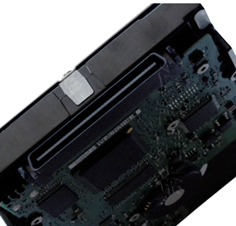
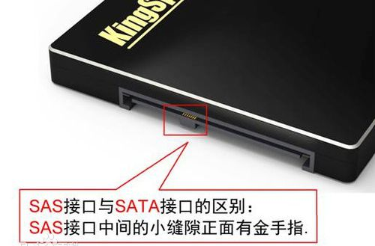
SCSI（Small Computer System Interface）
SAS（Serial Attached SCSI）
Notes:
SCSI 小型计算机系统专用接口,一种连接主机和外围设备的接口，支持包括硬盘、光驱及扫描仪在内的多种设备。SCSI 总线是一种并行总线，常用于企业级存储领域。其优点是适应面广，性能高，硬盘转速快（15000RPM），缓存容量大，CPU占用率低，扩展性远优于IDE硬盘，并且支持热插拔等
SAS跟SATA 硬盘有点类似，都是采用串行技术以获得更高的传输速度。SAS 的接口技术可以向下兼容SATA

Slide 18
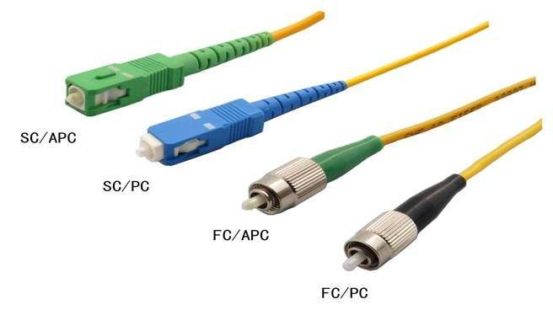
FC（Fiber Channel）
Notes:
FC即为光纤通道技术，最早应用于SAN （存储局域网络）。

Slide 19
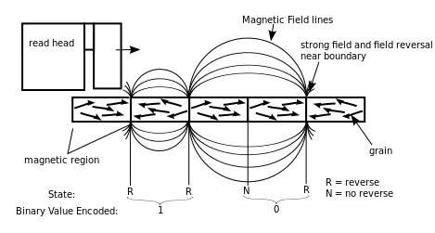
How a Hard Drive Works

Slide 20
Disk Partitions磁盘分区
Logical subdivision of a physical disk 硬盘逻辑子分区
Has a file format, stores files 有文件系统，存放文件
Each drive can have multiple partitions 每个磁盘可以有多个分区
Each operating system requires a separate partition

Slide 21
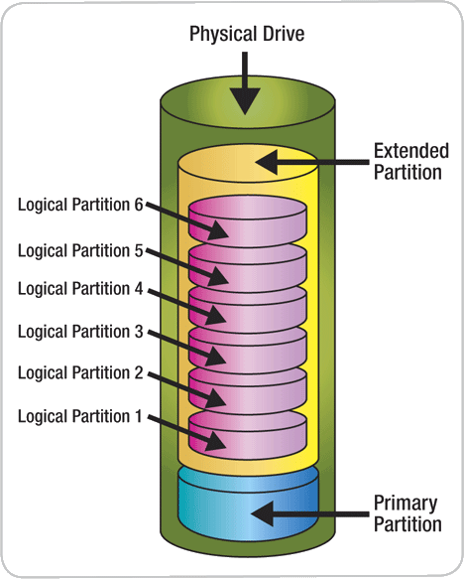
Partitions分区

Slide 22
Partition Styles分区类型
Master Boot Record (MBR)主引导记录
  Partition Table 分区表
  4 primary partitions or 3 primary + 1 extended
  BIOS for booting 启动阶段BIOS
GUID Partition Table (GPT)
  Partition data within partitions
  Redundant backup tables
  EFI for booting

Slide 23
Bootloader
BIOS 基本输入输出系统
  Uses MBR disks for booting 利用主引导记录磁盘进行启动
  Master boot code in 1st sector 位于第一个扇区的主引导代码
EFI
  Uses GPT disks for booting
  ESP (EFI System Partition) & MSR (Microsoft Reserved) partition required

Slide 24
Basic vs. Dynamic
Basic
  Drives correspond to partitions 磁盘对应分区
  Cannot modify on the fly
Dynamic
  Allows spanning & RAID 允许扩展
  Can modify on the fly (somewhat)

Slide 25
Windows Formats
FAT/FAT32
  File Allocation Table文件分配表
  FAT: <4GB; FAT32: <32GB 文件最大尺寸
  Simple Access Controls简单访问控制
NTFS
  New Technology File System新技术文件系统
  File info stored as Database 文件信息以数据库形式存放
  Advanced Access Controls 高级别访问
Notes:
NTFS:支持元数据，并且使用了高级数据结构，以便于改善性能、可靠性和磁盘空间利用率，并提供了若干附加扩展功能，如访问控制列表（ACL）和文件系统日志。该文件系统的详细定义属于商业秘密 ，但 Microsoft 已经将其注册为 知识产权产品

Slide 26
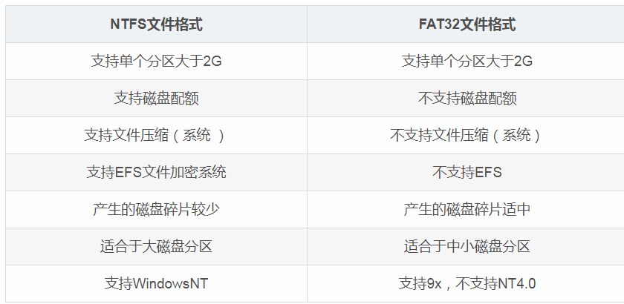

Slide 27
Linux Formats
exFAT
  File Allocation Table文件分区表
  Similar to Windows FAT32
ext3/ext4
  Extended File System扩展文件系统
  Up to 1 Exbibyte (~10¹⁸ bytes)
  Journals Protect Against Crashes采用日志保护系统坍塌

Slide 28
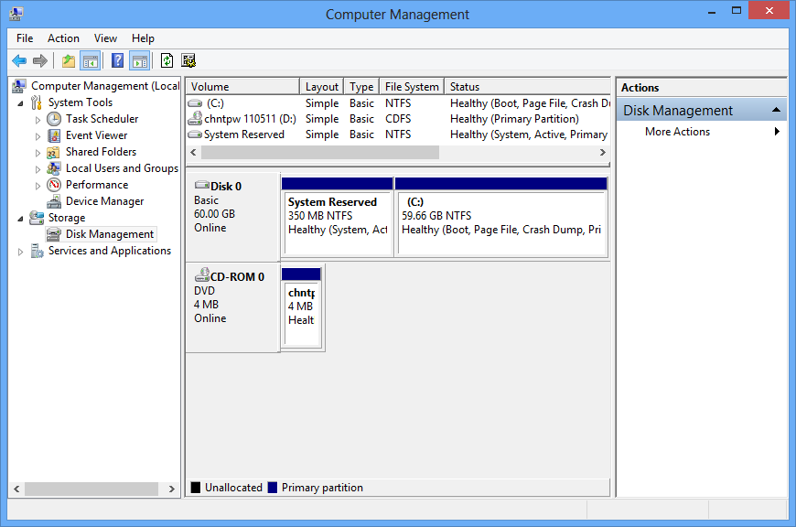
Windows Disk Management

Slide 29
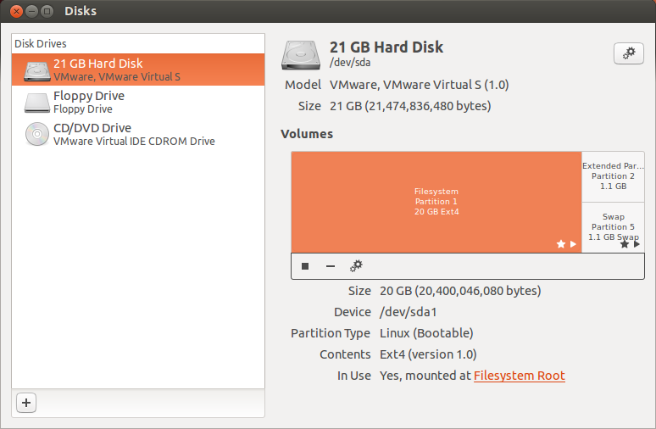
Ubuntu Disk Management

Slide 30
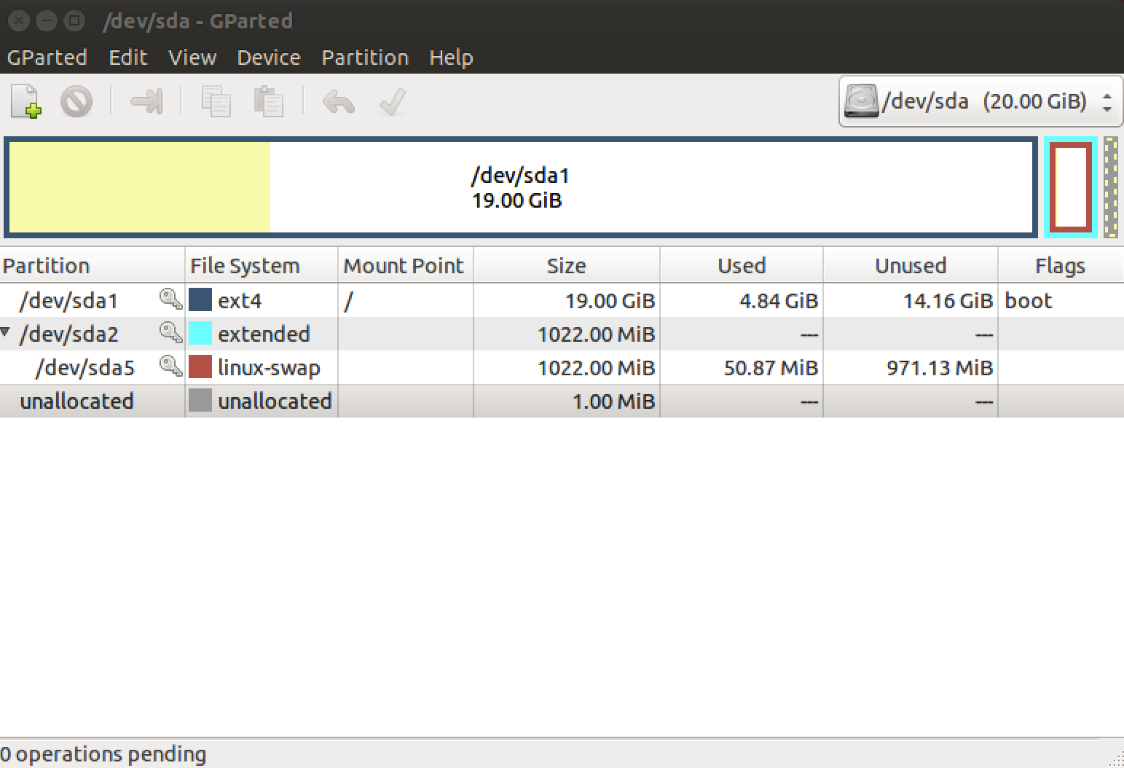
GParted
https://gparted.org/

Slide 31
Partition分区
Partition will be named numerically based on the count of the partition on disk. They are based on the disk device. Here are a few examples:
  SATA Disk 1, Partition 1:
    /dev/sda1
  SATA Disk 2, Partition 1:
    /dev/sdb1
  SATA Disk 2, Partition 2:
    /dev/sdb2

Slide 32
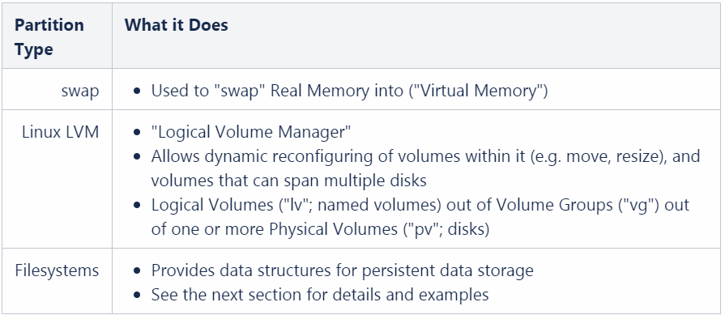
Partition分区
Each partition is tagged with a type which defines what kind of data can be stored there. Here are a few common types:

Slide 33
File Permissions
Determines which users can read/write files or folders
Based on user and group memberships and file settings
Helps prevent unwanted access to files

Slide 34
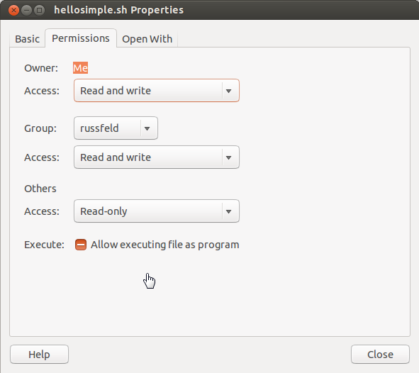
Ubuntu Permissions

Slide 35
Ubuntu Permissions
3 classes: User, Group, Others
3 rights:
  Read - Can read contents
  Write - Can create/modify/delete
  Execute - Can run programs/scripts

Slide 36
Modifying Ubuntu Permissions
chmod - Change permissions
  chmod [class][op][mode] file/folder
  chmod [octal_mode] filename/folder
chown - Change User/Group (sudo)
  chown [user]:[group] filename/folder
chgrp - Change Group (must own file)
  chgrp [group] filename/folder

Slide 37
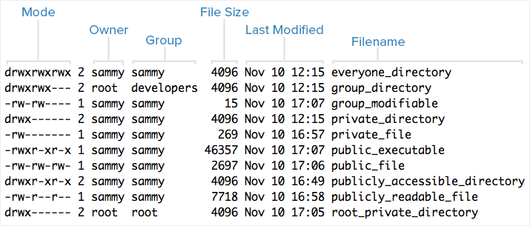
File Listing

Slide 38
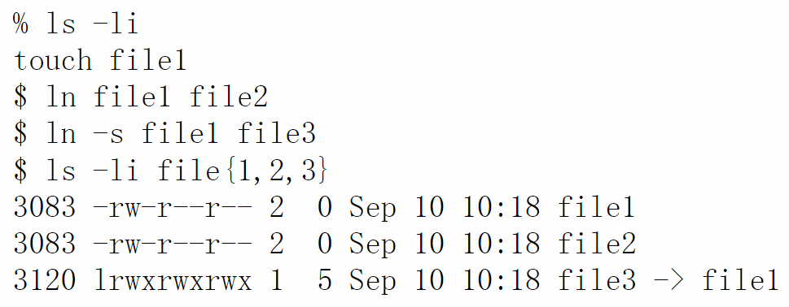
Symbolic Link
Hard links are ordinary directory entries
Soft links are ordinary files with a bit set to indicate that they are to be used to provide path information

Slide 39
Backup备份
RAID + journaling not enough to provide 100% availability.
Essential: backup copies:
  Solution for multiple unexpected events, both HW and SW.
  Mainly “the users”

Slide 40
Backup备份
Performed with dedicated resources:
  Hard Disks:
    Exclusively dedicated to backup. 专用存储
    SAN Servers. 区域存储网络服务器
    Disk hierarchy with decreasing performance.
  Tapes(or other magnetic support):磁带
    LTO (Linear Tape-Open) (LTO-6 Ultrium):
      2.5TB capacity, 160MB/s transference.
    Others: SAIT, AIT

Slide 41
Backup备份
Backup Policy: Configured according to our requirements: 备份策略取决于具体需求
  What do we need to store?: 存储什么
    Data from users/apps/system. 各种数据
    Select the critical parts of the system. 系统关键数据
  When do we want to backup?: 备份时间
    Do not overload systems with useless work. 不给系统造成巨大负担
    Depends on the kind of utilization and the part of the file system 文件系统的使用情况
    employ programming/automazition on mechanisms (cron). 可以采用自动化方法进行备份

Slide 42
Backup备份
Basic system tool: dump/restore: 常用工具
  Present in most UNIX/Linux systems.
  Many advanced tools employ this as starting point. 其它高级的工具都是基于dump/restore
  Designed to work at File System level: 文件系统级别的备份工具
    Can copy any kind of file (even devices). 可以复制任何文件
    Preserves permissions, property and timestamps of files. 保留文件权限、时间戳等元数据

Slide 43
Backup备份
Backups are incremental (backup levels):
  Only available for the whole File Systems.
  Level 0: (FULL) copies all files from scratch.
  Level 1: (INCREMENTAL) adds to the previous backup only modified files.
  Level N: adds to the previous backup the files modified since the last time a “less than N” backup was performed.
  The information about backup history is stored in /etc/dumpdates. 备份历史记录存放在

Slide 44
Backup备份
Creation of backups with dump command:
  Syntax: dump -<level> <options> -f [destination] [File system]:
    Level: int from 0 (FULL) to 9.
    Option–f: destination of backup file. Can be a device file (tape).
    Option –u: update the file /etc/dumpdates after the backup.
    Example: # dump -0u –f /dev/tape /

Slide 45
Backup
Recovery with restore command: 恢复指令
  restore –C: compare the stored File system (from /).
  restore –i: interactive operation with backup:
    add/delete: files/dirs. To the restoration list.
    cd/ls/pwd: move through the backup FS (Files with * are in the restoration list).
    extract: restore the files from the list.
  restore –r: restore the whole file system:
    # restore –r –f <back_file> <destination>

Slide 46
Backup
Alternative tools (rudimentary):
  Command tar (package):
      Can understand devices without file system.
      Can be completed with compression tools (bzip, zip).
  Command dd:
      # dd if=/dev/sda2 of=/dev/tape.
  Command cp –a: opmal to replicate disk content (at file level).

Slide 47
Reference
https://man.linuxde.net/dump
https://idc.wanyunshuju.com/cym/105.html

Slide 48



The End

